Slide 1
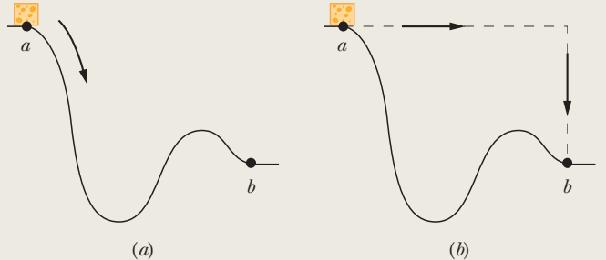
The main lesson of this sample problem is this: It is perfectly all right to choose an easy path instead of a hard path. Figure 8-5a shows a 2.0 kg block of slippery cheese that slides along a frictionless track from point a to point b. The cheese travels through a total distance of 2.0 m along the track, and a net vertical distance of 0.80 m. How much work is done on the cheese by the gravitational force during the slide?

Slide 2
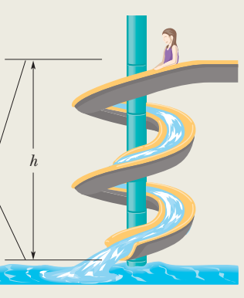
The huge advantage of using the conservation of energy instead of Newton’s laws of motion is that we can jump from the initial state to the final state without considering all the intermediate motion. Here is an example. In Fig., a child of mass m is released from rest at the top of a water slide, at height h = 8.5 m above the bottom of the slide. Assuming that the slide is frictionless because of the water on it, find the child’s speed at the bottom of the slide.

Slide 3
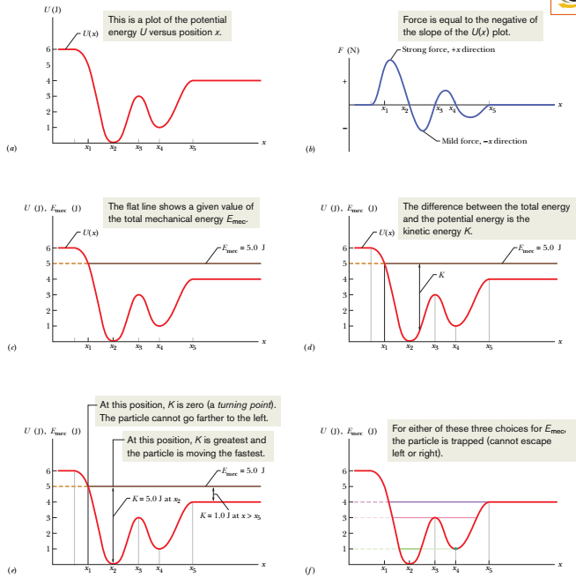

Slide 4
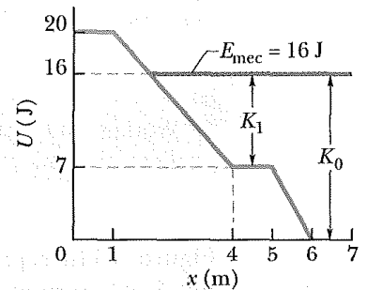
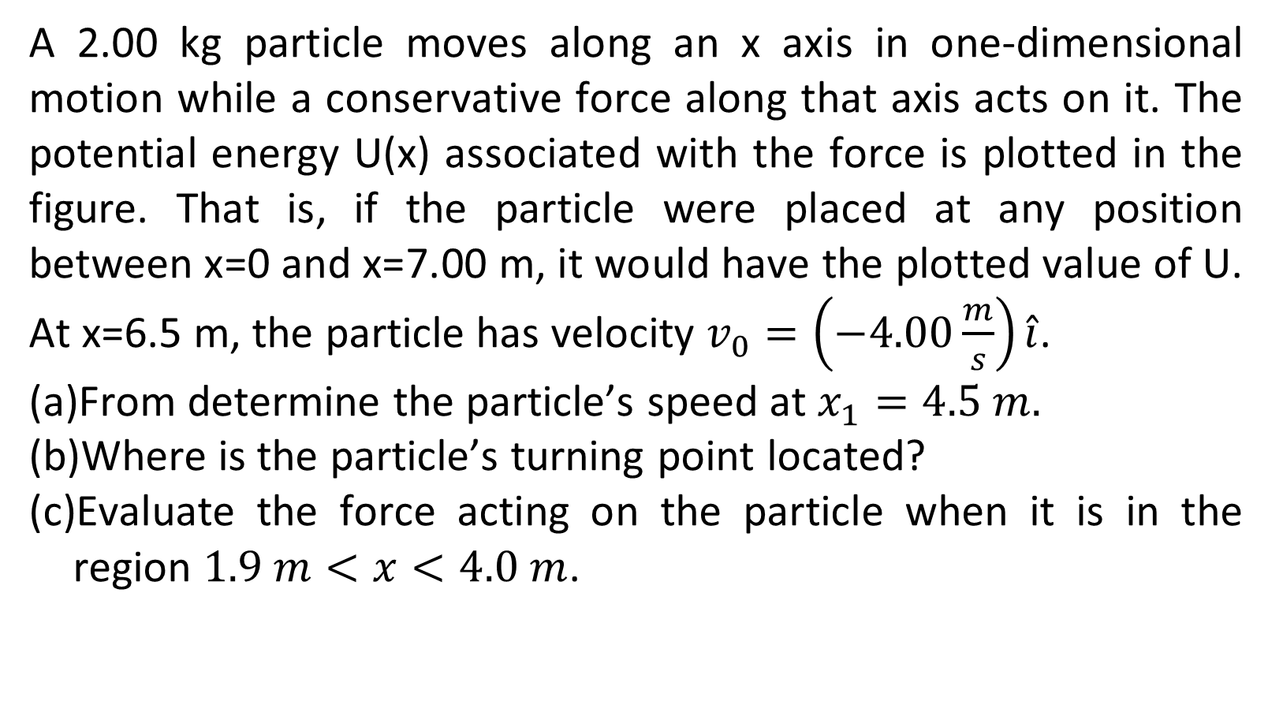
A 2.00 kg particle moves along an x axis in one-dimensional motion while a conservative force along that axis acts on it. The potential energy U(x) associated with the force is plotted in the figure. That is, if the particle were placed at any position between x=0 and x=7.00 m, it would have the plotted value of U. At x=6.5 m, the particle has velocity $v_{0}=\left(−4.00\frac{m}{s}\right)\hat{i}$.
From determine the particle’s speed at $x_{1}=4.5 m.$
Where is the particle’s turning point located?
Evaluate the force acting on the particle when it is in the region $1.9 m<x<4.0 m$.

Slide 5
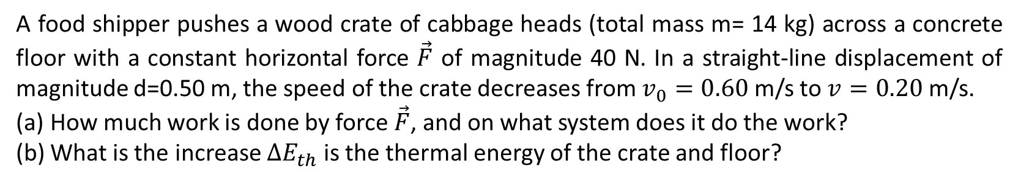
A food shipper pushes a wood crate of cabbage heads (total mass m= 14 kg) across a concrete floor with a constant horizontal force $\vec{F}$ of magnitude 40 N. In a straight-line displacement of magnitude d=0.50 m, the speed of the crate decreases from $v_{0}=0.60$ m/s to $v=0.20$ m/s.
How much work is done by force $\vec{F}$, and on what system does it do the work?
What is the increase $∆E_{th}$ is the thermal energy of the crate and floor?

